Slide 1


Deployed Medical & Healthcare Delivery
BUILDING NEW CBRN CAPABILITIES TO RESPOND TO FUTURE THREATS
Brigadier General Roman JANTOS
Surgeon General of the SVK Armed Forces

Slide 2
Agenda
Deployed Medical & Healthcare Delivery
SVK MILMED Service Plans
All-Out War preparations
CBRN capabilities

Slide 3
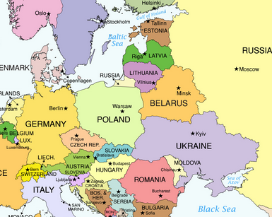
Deployed Medical & Healthcare Delivery
695 km
263 km
LVIV

Slide 4
1. SVK MILMED Service Plans
Deployed Medical & Healthcare Delivery
CHOD
Joint Operation Command
Land Force
Command
Air Force Command
Special Operation Force Command
MOD
Military Medical Command
Military Hospital
Joint Support Brigade

Slide 5
1. SVK MILMED Service plans
Deployed Medical & Healthcare Delivery
Revision of capabilities and capacities
Interministerial permament board – crisis response planning
Ongoing investments
2026 New structure od Military Medical Commad
New Military Hospital

Slide 6
1. SVK MILMED Service plans
Deployed Medical & Healthcare Delivery
Interministerial permament board – crisis response planning
Legislation
Crisis medical beds
Medical supplies
Production of Med supplies
Blood sustainibility
CBRN
Bulk MEDEVAC
Hospital crisis planning

Slide 7
2. All-Out War preparations
Deployed Medical & Healthcare Delivery
Revision of Plans
Maping of suitable infrastructure for medical
Medical personnel in civilian facilities
TOA of deployable medical facilities
PECCs down up to brigade level

Slide 8
2. All-Out War preparations
Deployed Medical & Healthcare Delivery
Bulk MEDEVAC - Bus (military), Train (national) ???
Cross-coordination with MoH
Emergency Medical Service coordination
MED-AMB capability a capacity

Slide 9
3. CBRN - Why
Deployed Medical & Healthcare Delivery
Real threat (white phosphorus, nerve agents....)
Bi-SC CAPABILITY CODES AND CAPABILITY STATEMENTS (pages 256-273)

Slide 10

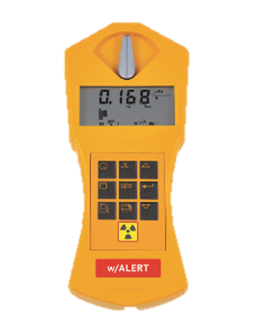

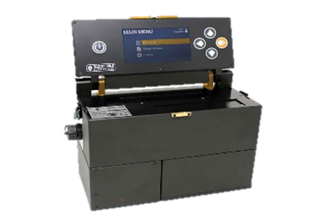
3. CBRN - What
Deployed Medical & Healthcare Delivery
Individual training (protective gear, procedures, antidots...)
Collective training
Medical implications – detect, decon, isolate and treat

Slide 11
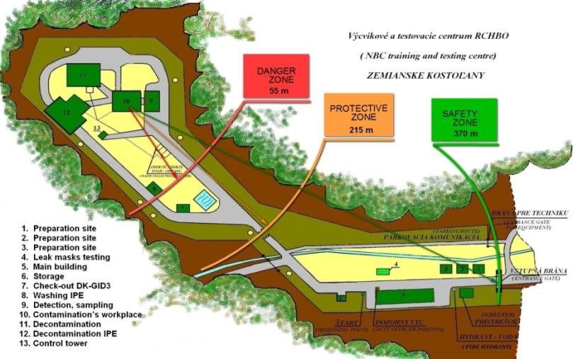

3. CBRN - What
Deployed Medical & Healthcare Delivery
NBC training and Test Centre

Slide 12
3. CBRN - What
Deployed Medical & Healthcare Delivery
Own detection and decontamination
Toxicology and Highly infectious diseases dpt
DOIT
Protected MEDEVAC Assets

Slide 13
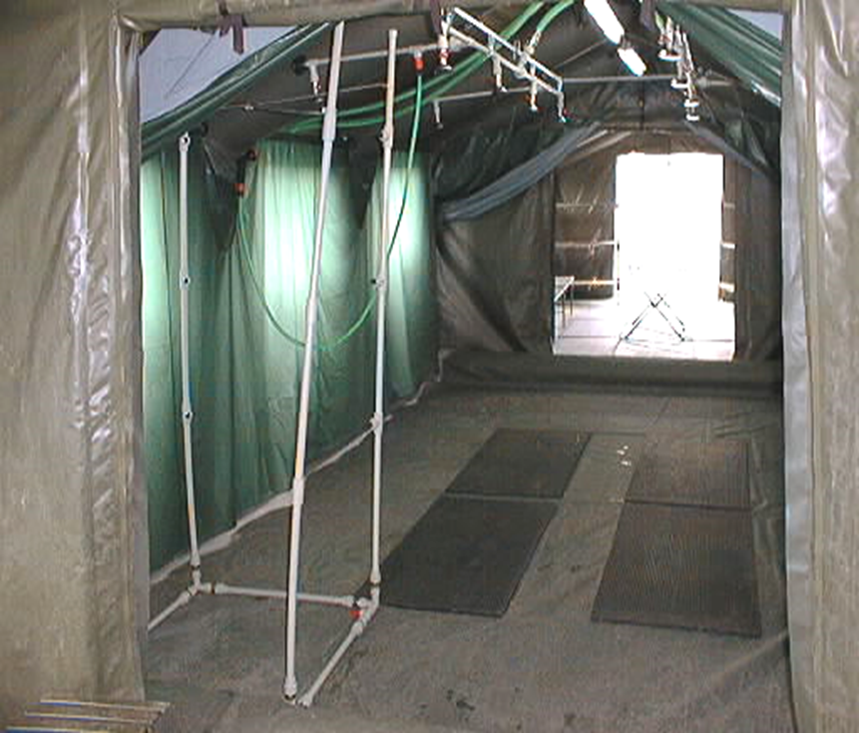
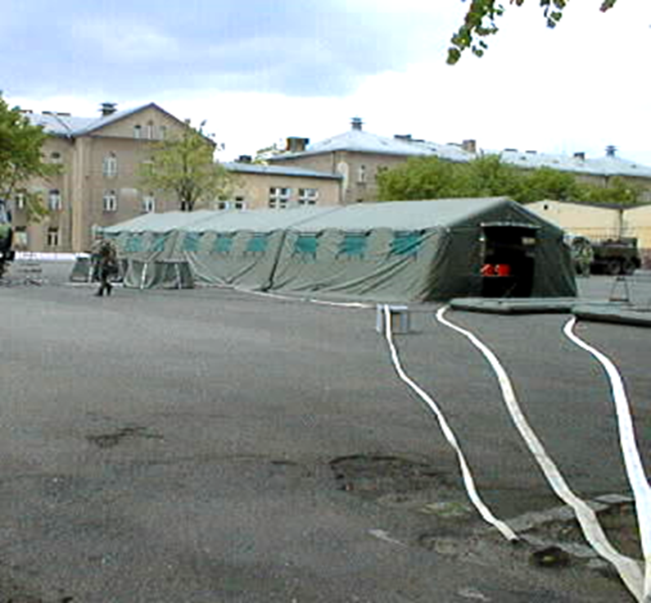
3. CBRN - What
Deployed Medical & Healthcare Delivery

Slide 14
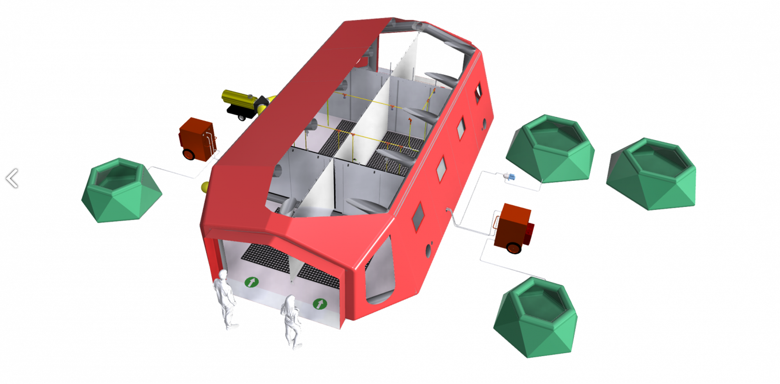
3. CBRN - What
Deployed Medical & Healthcare Delivery

Slide 15
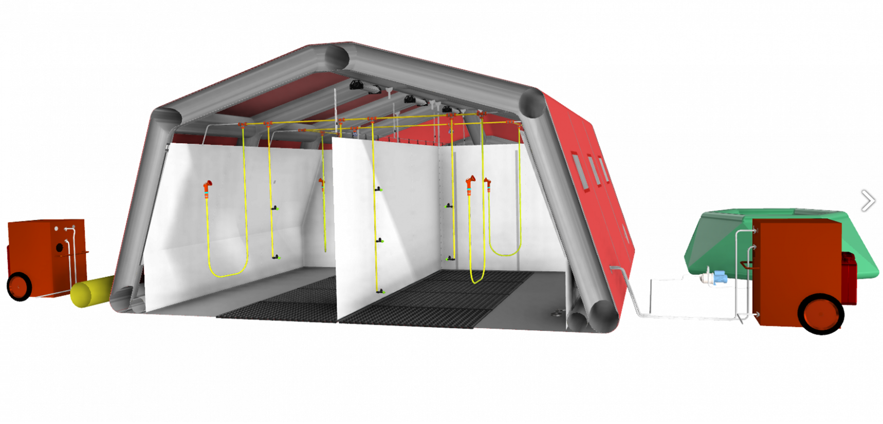
3. CBRN - What
Deployed Medical & Healthcare Delivery

Slide 16
3. CBRN - MEDEVAC
Deployed Medical & Healthcare Delivery
8x8 Armoured ambulance – DONE
4x4 Soft Skin ambulance – in progress
4x4 Armoured ambulance – in preparation

Slide 17
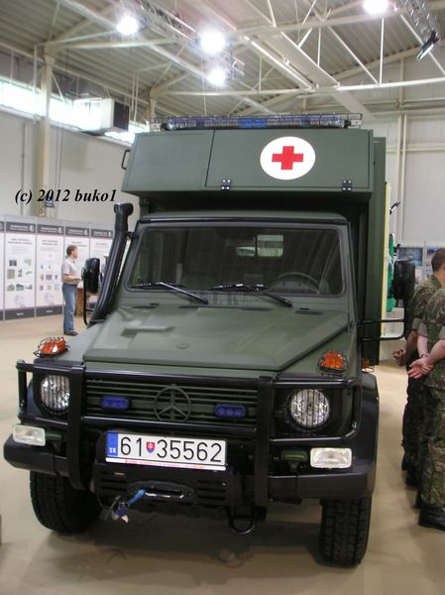
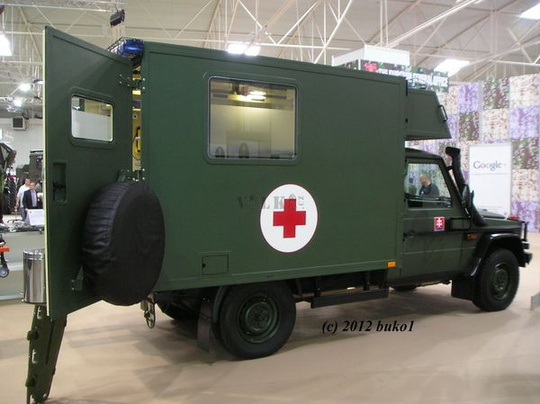
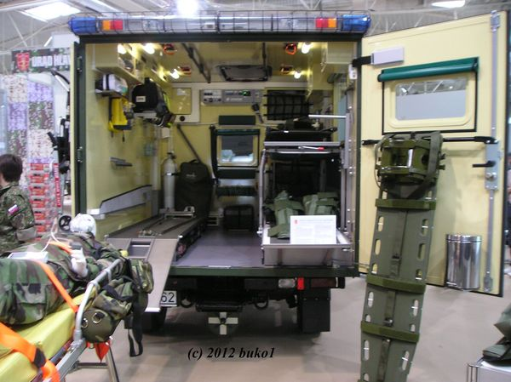
Deployed Medical & Healthcare Delivery

Slide 18
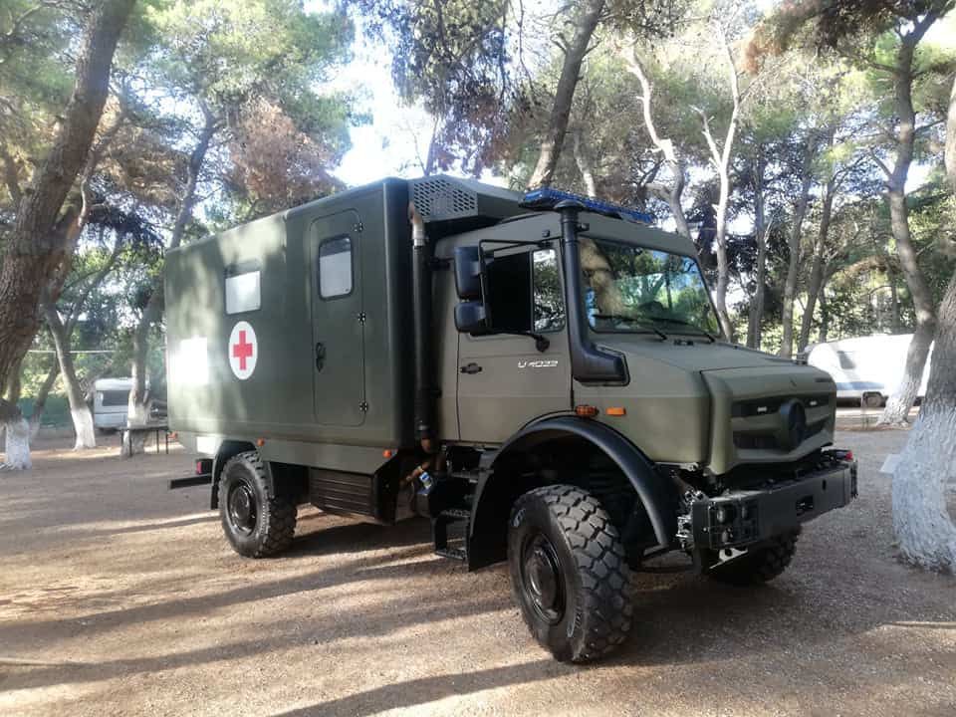
Deployed Medical & Healthcare Delivery

Slide 19
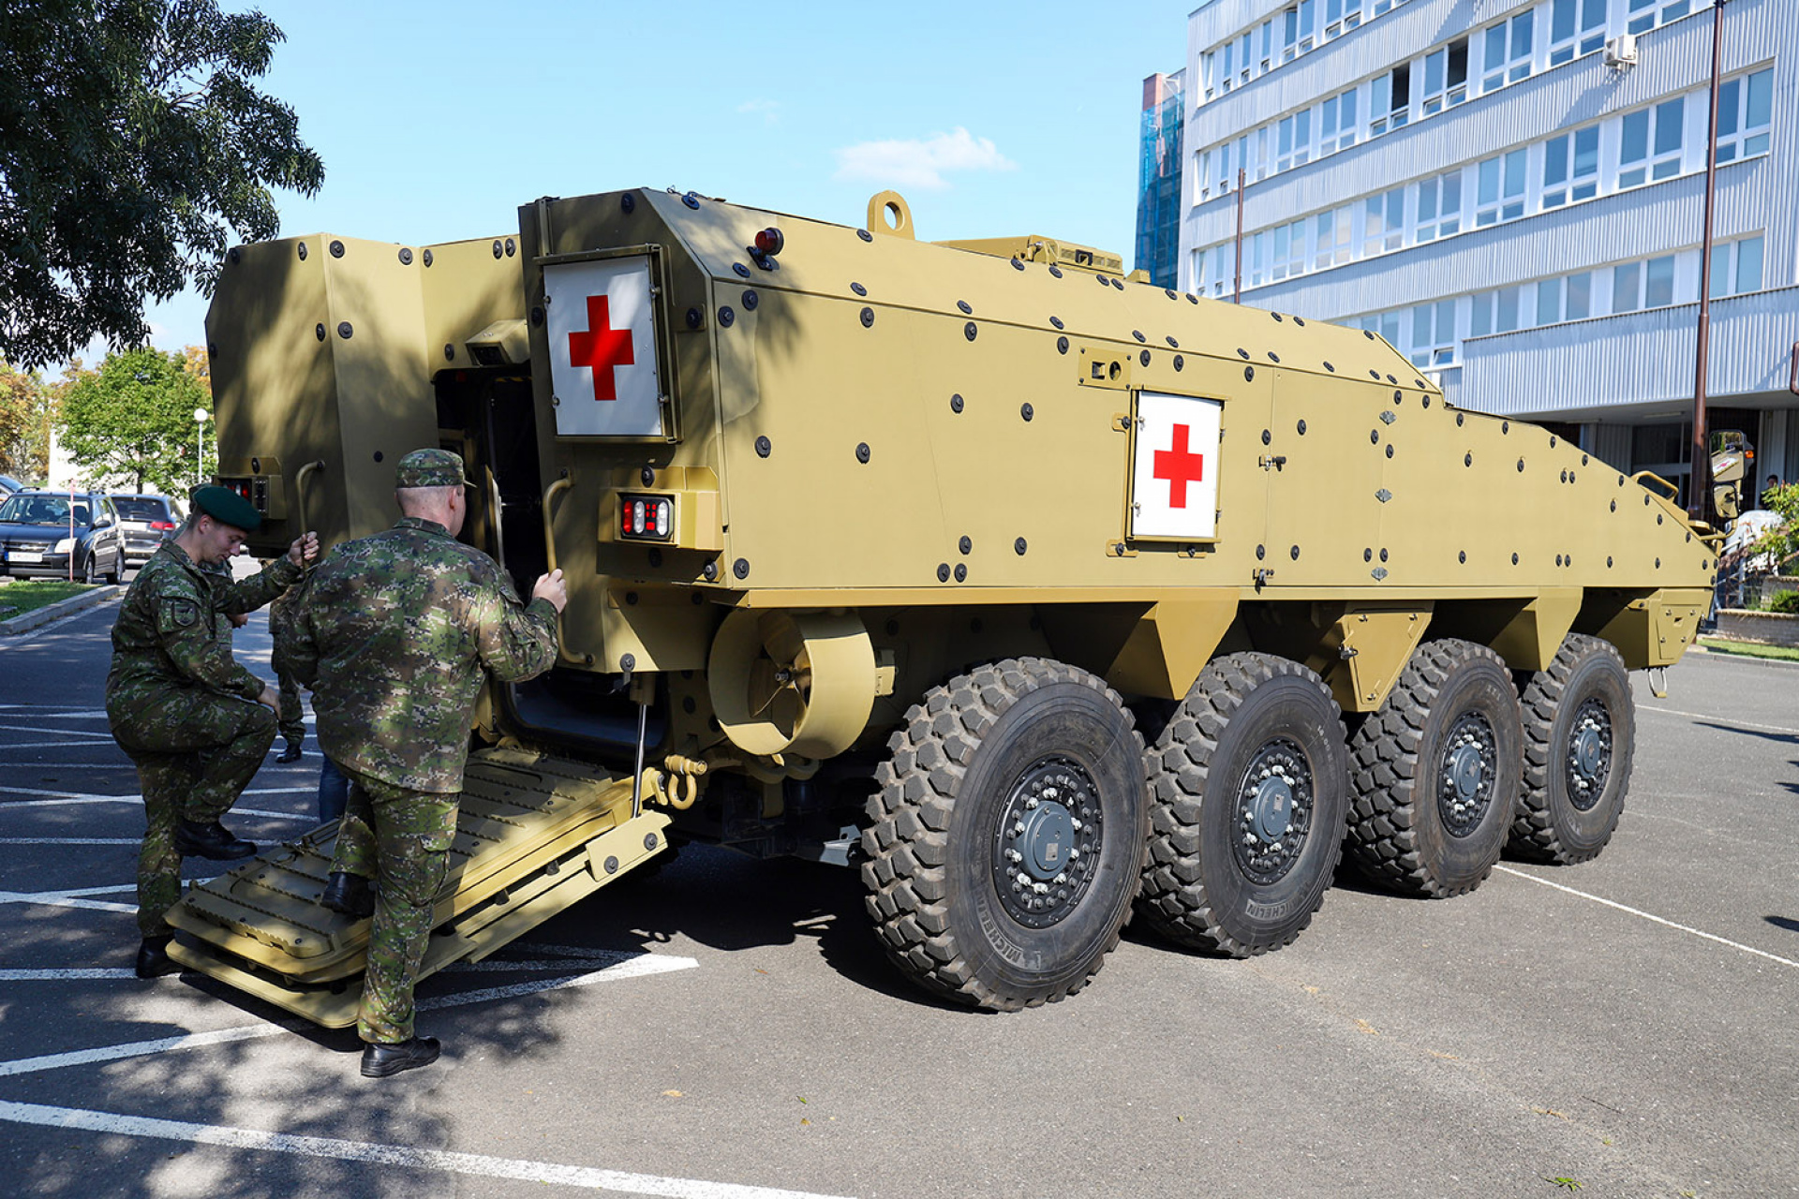
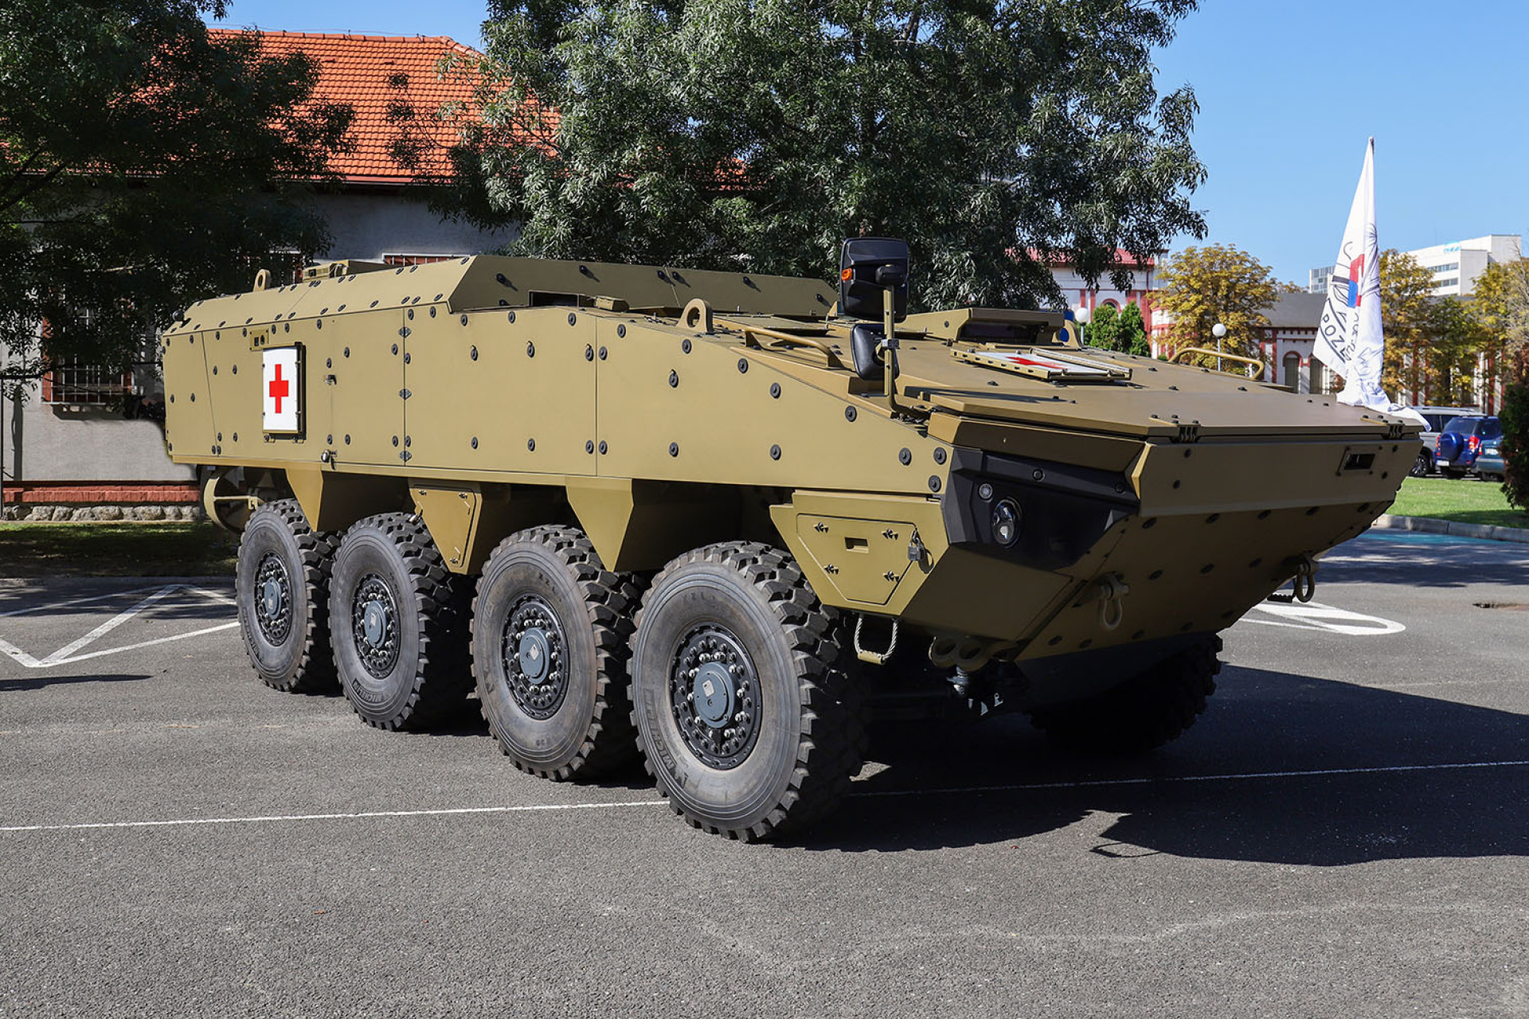
Deployed Medical & Healthcare Delivery

Slide 20
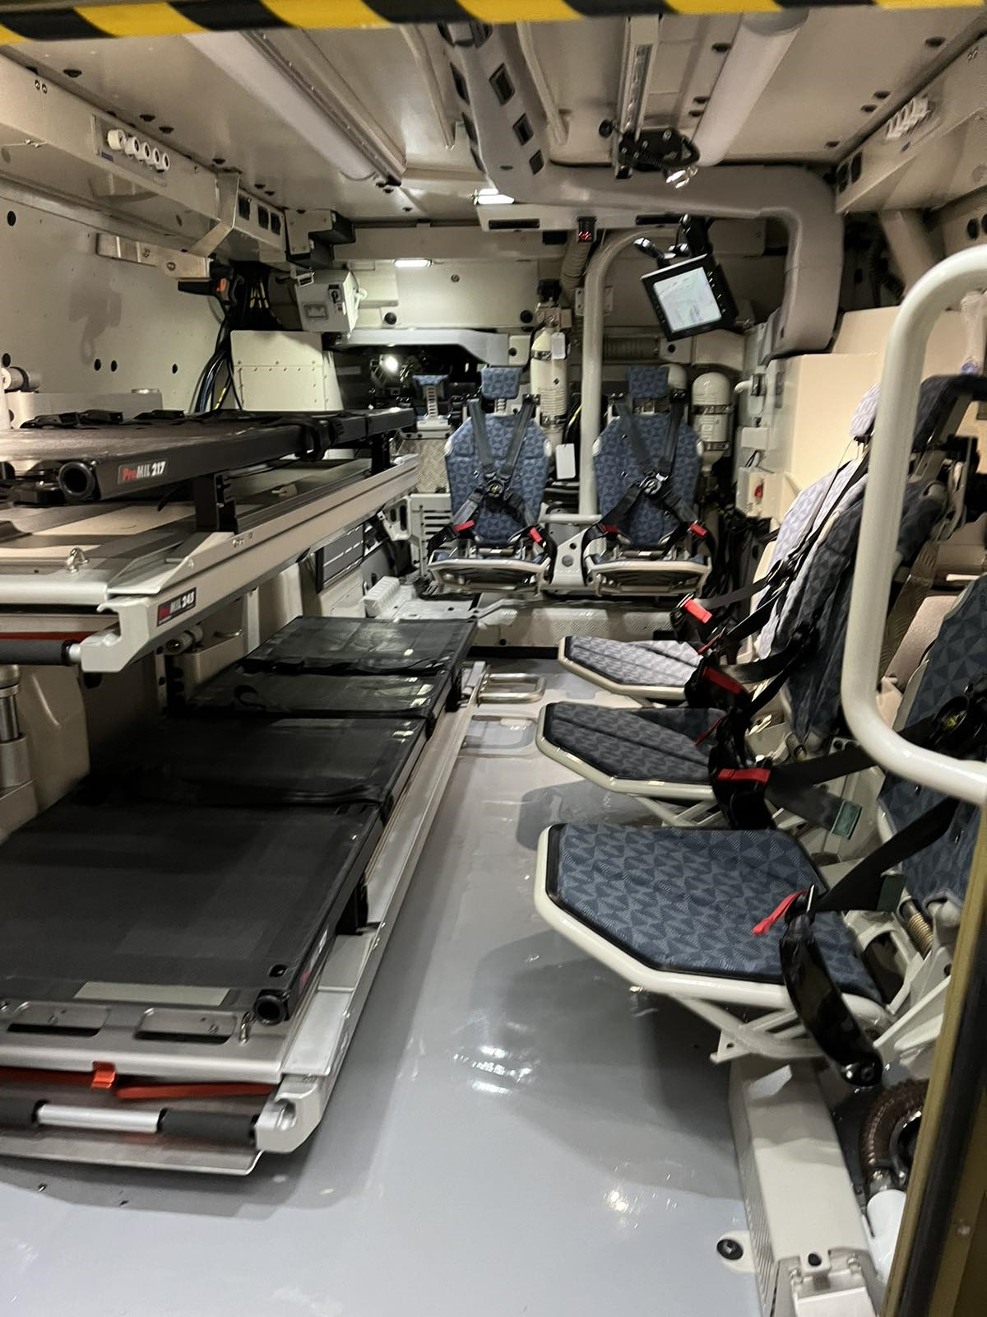
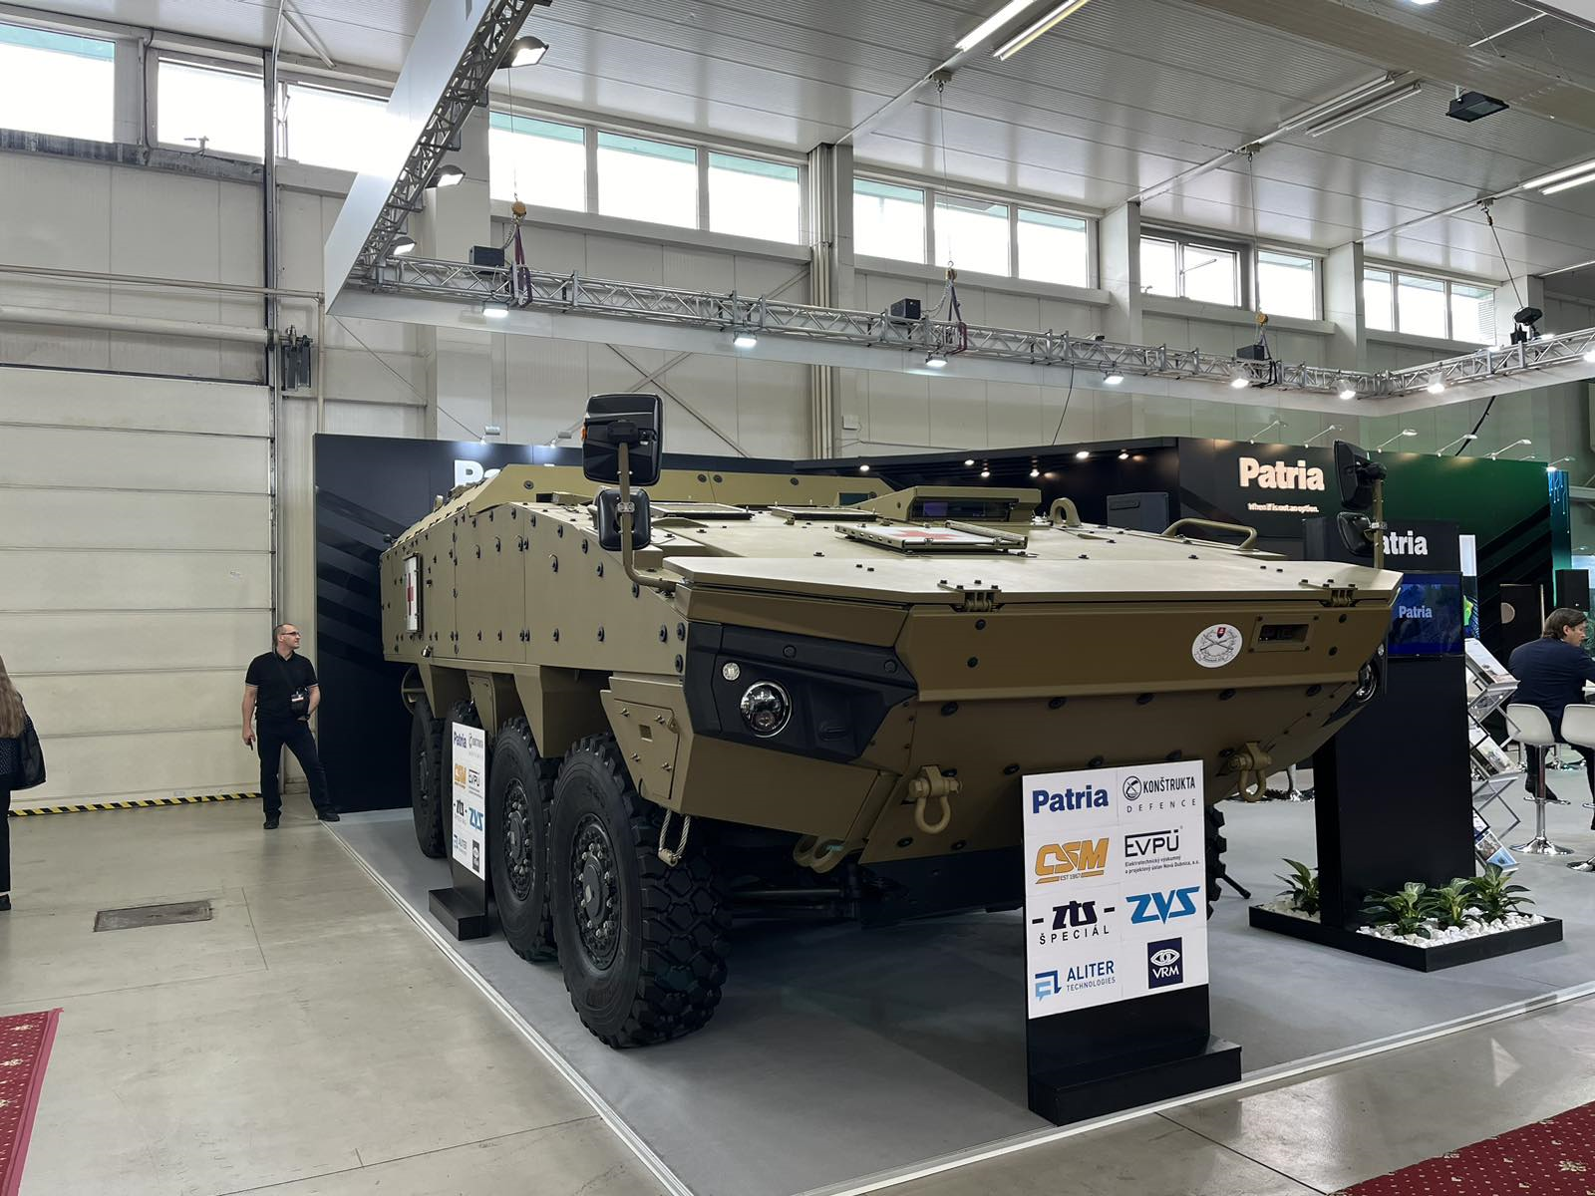
Deployed Medical & Healthcare Delivery

Slide 21
Deployed Medical & Healthcare Delivery
Thank You

